Slide 1
esp32
loop
cmd_vel_callback
set_pwm_value
cmd_vel
(linear.x, angula.z)
->vLeft, vRight
->pwmLeftReq
pwmRightReq
pwmLeftReq
pwmRightReq
velLeftWheel
velRightWheel
-> pwmLeftOut
pwmRightOut
-> ledcWrite
subscribe
calc_vel
publish
mpu_loop
sub_cmd_vel
….
velLeftWheel
velRightWheel
pub_left_tick
pub_right_tick
pub_quaternion
quaternion
모터
attachInterrupt
left_wheel_tick right_wheel_tick dmpDataReady(mpuIntStatus)
라즈베리파이

Slide 2
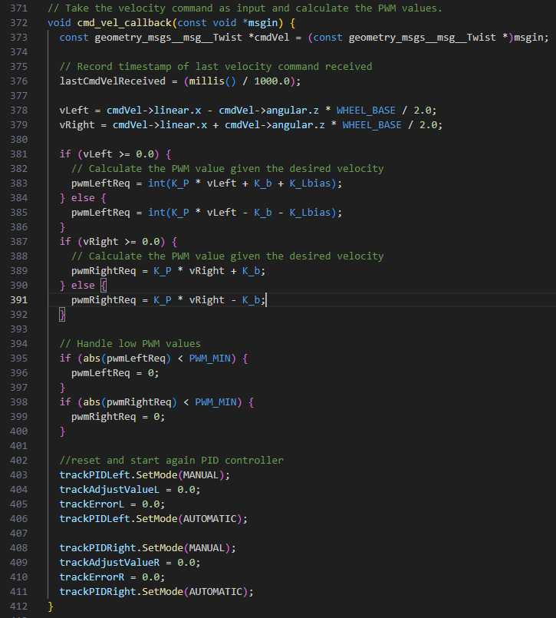
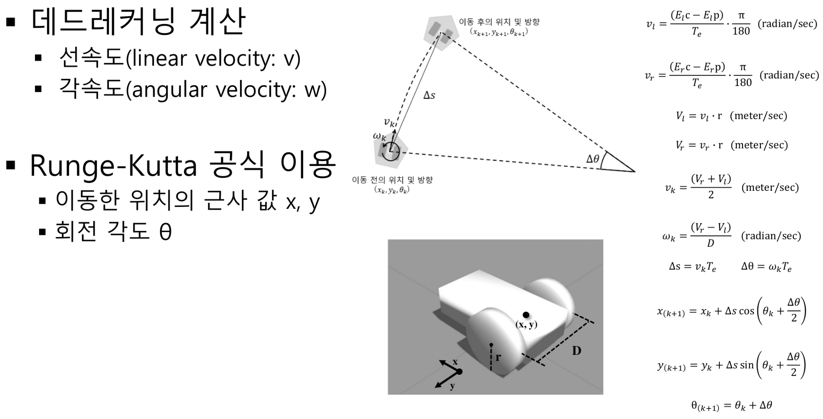
cmd_vel_callback
cmd_vel
(linear.x, angula.z)
->vLeft, vRight
->pwmLeftReq
pwmRightReq
angular.z
angular *D /2
linear.x
linear.x
- angular.z *D /2
linear.x
+ angular.z *D /2

Slide 3
데드레커닝 계산
병진 속도 (linear velocity: v)
병진 속도 (angular velocity: w)
Runge-Kutta 공식 이용
이동한 위치의 근사 값 x, y
회전 각도 θ

Slide 4
cmd_vel_callback
cmd_vel
(linear.x, angula.z)
->vLeft, vRight
->pwmLeftReq
pwmRightReq

Slide 5
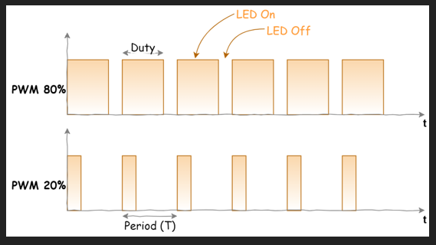
PWM

Slide 6
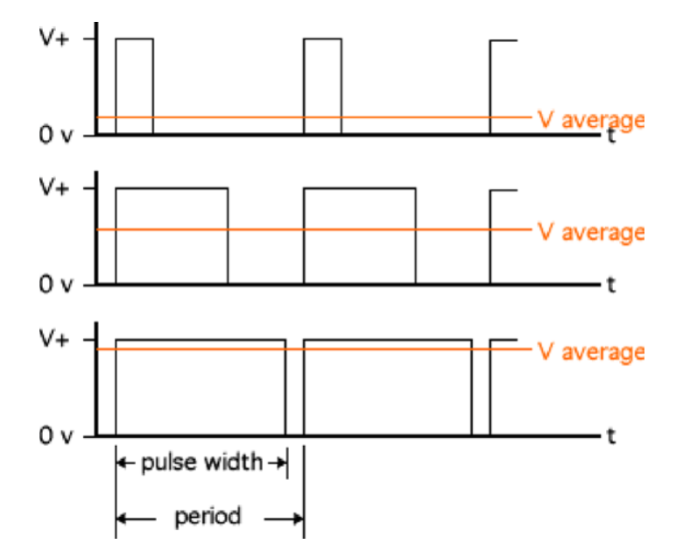

Slide 7
esp32
loop
cmd_vel_callback
set_pwm_value
cmd_vel
(linear.x, angula.z)
->vLeft, vRight
->pwmLeftReq
pwmRightReq
pwmLeftReq
pwmRightReq
velLeftWheel
velRightWheel
-> pwmLeftOut
pwmRightOut
-> ledcWrite
subscribe
calc_vel
publish
mpu_loop
sub_cmd_vel
….
velLeftWheel
velRightWheel
pub_left_tick
pub_right_tick
pub_quaternion
quaternion
모터
attachInterrupt
left_wheel_tick right_wheel_tick dmpDataReady(mpuIntStatus)
라즈베리파이

Slide 8
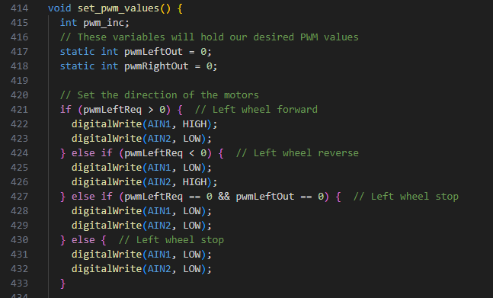
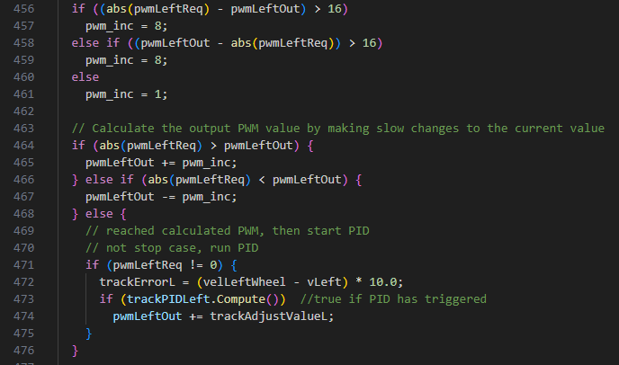
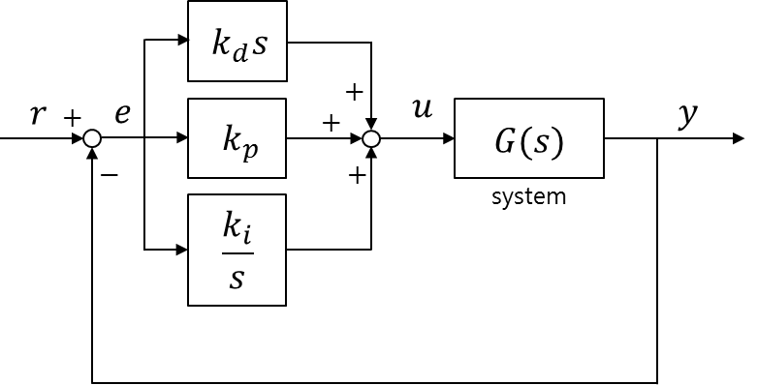
set_pwm_value
pwmLeftReq
pwmRightReq
velLeftWheel
velRightWheel
-> pwmLeftOut
pwmRightOut
-> ledcWrite
모터

Slide 9
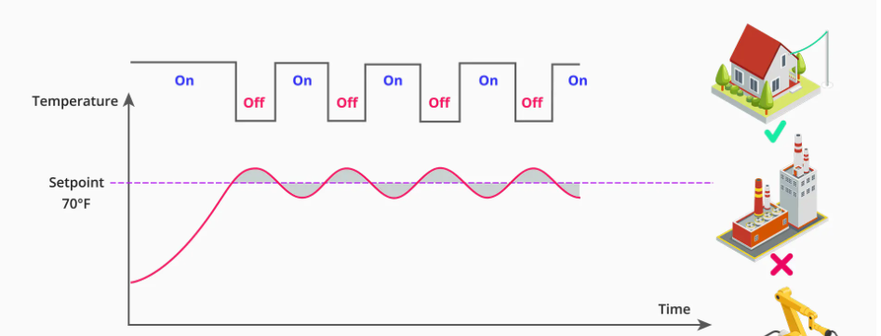

Slide 10
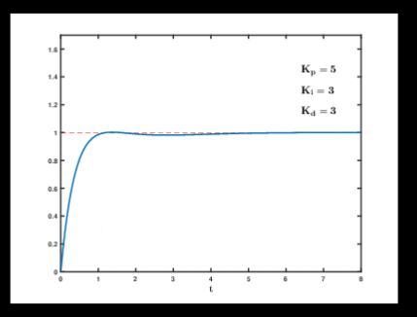
pid 관련 링크
https://setoo0922.tistory.com/259

Slide 12
set_pwm_value
pwmLeftReq
pwmRightReq
velLeftWheel
velRightWheel
-> pwmLeftOut
pwmRightOut
-> ledcWrite
모터

Slide 13


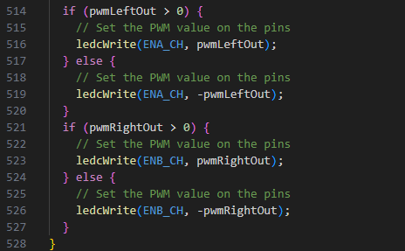
set_pwm_value
pwmLeftReq
pwmRightReq
velLeftWheel
velRightWheel
-> pwmLeftOut
pwmRightOut
-> ledcWrite
모터

Slide 14
esp32
loop
cmd_vel_callback
set_pwm_value
cmd_vel
(linear.x, angula.z)
->vLeft, vRight
->pwmLeftReq
pwmRightReq
pwmLeftReq
pwmRightReq
velLeftWheel
velRightWheel
-> pwmLeftOut
pwmRightOut
-> ledcWrite
subscribe
calc_vel
publish
mpu_loop
sub_cmd_vel
….
velLeftWheel
velRightWheel
pub_left_tick
pub_right_tick
pub_quaternion
quaternion
모터
attachInterrupt
left_wheel_tick right_wheel_tick dmpDataReady(mpuIntStatus)
라즈베리파이

